Slide 1
Depth Constraint without Depth Constraint
Using Hypocentroidal Decomposition (MLOC) to relocate cluster of earthquakes
Notes:
It is commonly the case that most events in a cluster have numerous Pn arrivals, but only a few events have good coverage in Pg/Sg range (direct crustal arrivals). Through analysis as a cluster, we can leverage the few events with good local-distance coverage (“control events”) to constrain focal depths of many events that have only one or a few crustal arrivals at distances that would normally not be adequate to constrain focal depth.

Slide 2
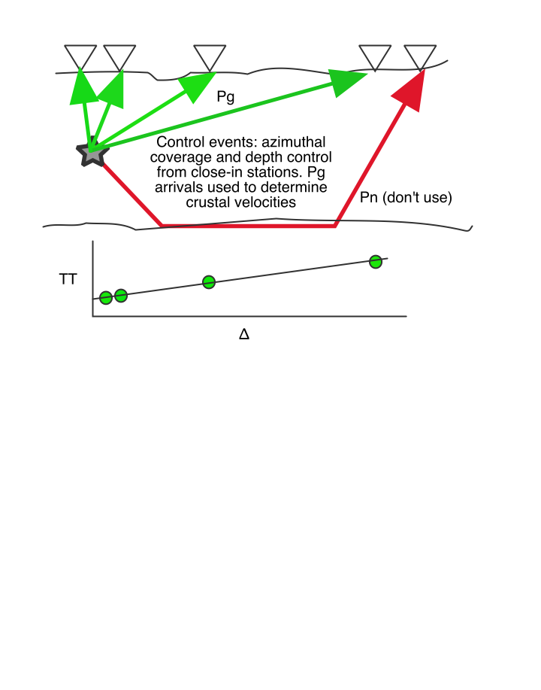
Notes:
Treated as a subcluster in HD, control events can be accurately located using all readings for cluster vectors and only direct crustal arrivals for hypocentroid. With Pg and Sg at short distances (within a couple focal depths) as well as greater distances, there is good constraint on depth in the normal manner (e.g., free depth solutions). With depths set accurately, the direct crustal arrivals can be used to refine the crustal velocity model (but not crustal thickness).

Slide 3
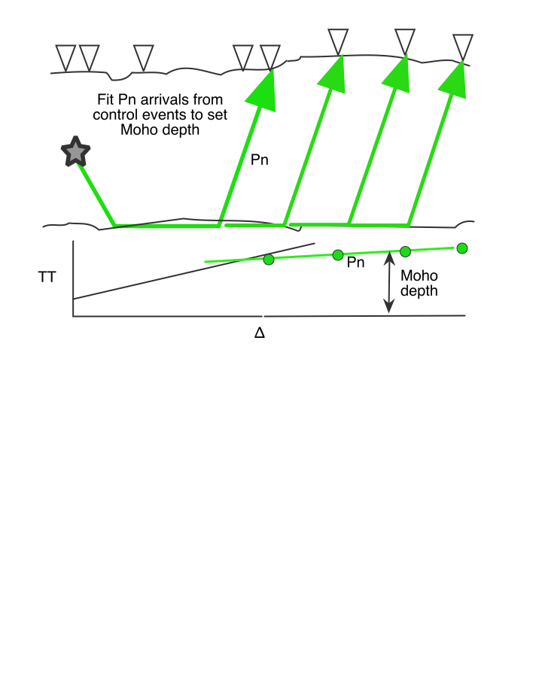
Notes:
Next, using the Pn arrivals for control events, the thickness of the crust (Moho depth) and upper mantle velocity can be constrained.

Slide 4
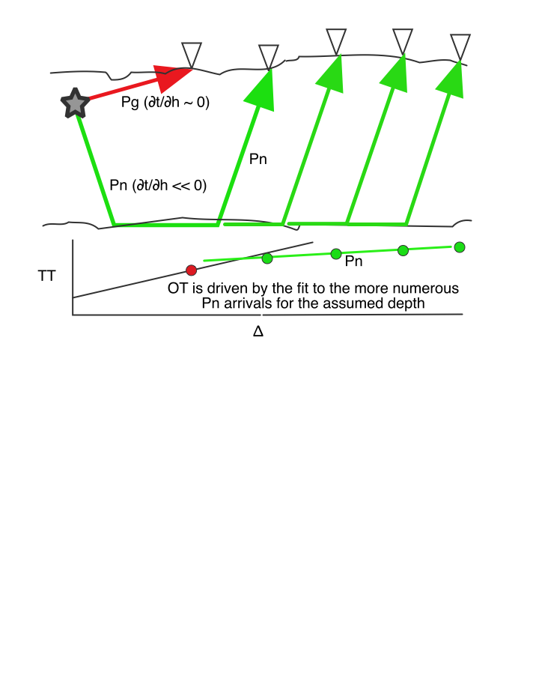
Notes:
A non-control event may have only a few direct crustal arrivals, and those at distances beyond what is normally needed for depth constraint (so ∂t/∂h is near zero). If such an event is added to the subcluster of control events, its OT will be driven by the fit of its Pn readings (steep take-off angles) to those of the control events, for the assumed focal depth.

Slide 5
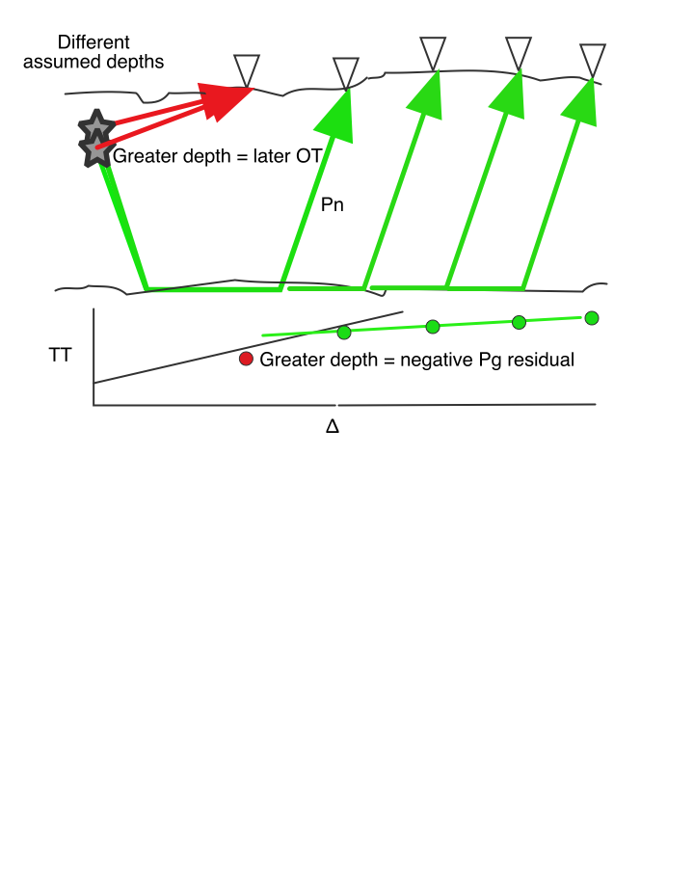
Notes:
What happens with different assumed depths for the non-control event? If the assumed depth is too great, OT must be later to still fit the Pn arrivals with shorter raypaths. The Pg arrival has almost no dependence on depth (raypath length stays the same) but it is affected by changes in OT. Later OT makes theoretical arrival time earlier, causing a negative residual, the same sense as if the station were much closer to the event. And the opposite for shallower assumed depths. Focal depth is adjusted so that the direct arrivals are consistent with the TT model for crustal arrivals based on the control events.

Slide 6
Caveats
At least one direct crustal arrival is required to constrain depths of non-control events.
The process must be done incrementally, adding one or a few events to the kernel of control events.
Free depth solutions are often not possible. Forward modeling is required in that case.
There is still potential for some trade-off between focal depth and assumed crustal velocities, even for the control events. The potential for bias increases with focal depth.

Slide 7
Nevertheless
The method substantially increases the number of events with useful depth constraint in many earthquake clusters.
Often useful for older (larger) events that occurred when there were fewer permanent stations.
Teleseismic phases play the same role as refracted phases, because of their steep take-off angles.
Uncertainty in depths constrained in this manner is typically about 3-4 km.

